Slide 1
3D Transformations and 3d- Viewing
B. Neelima

Slide 2
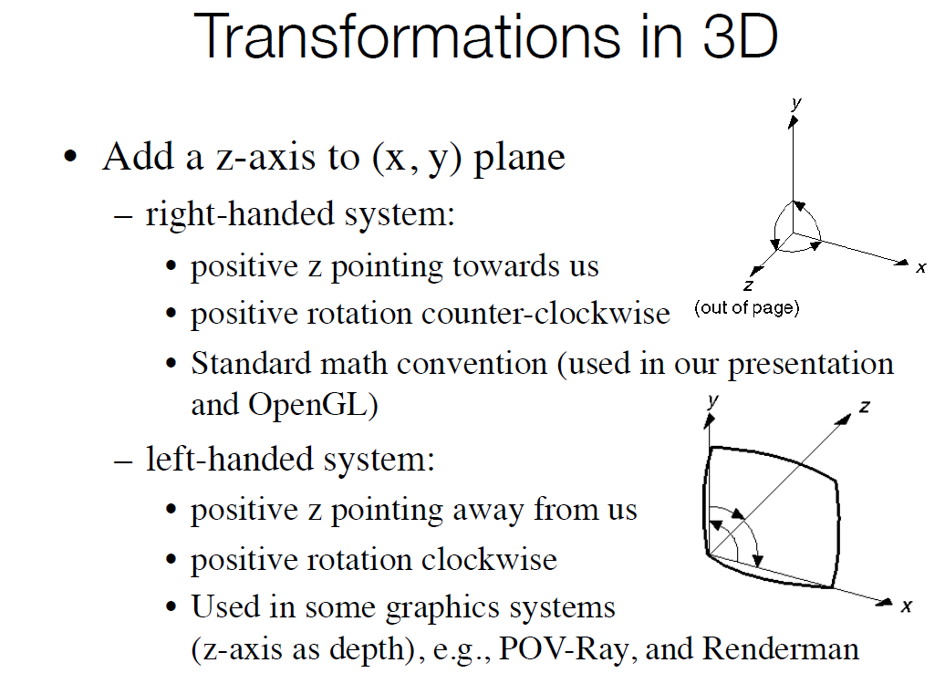

Slide 3
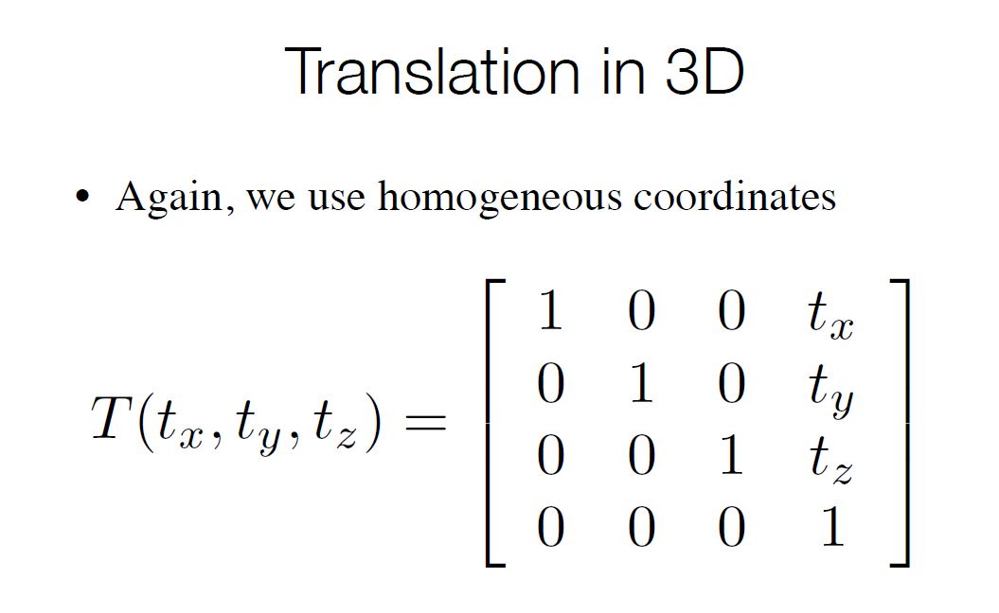

Slide 4
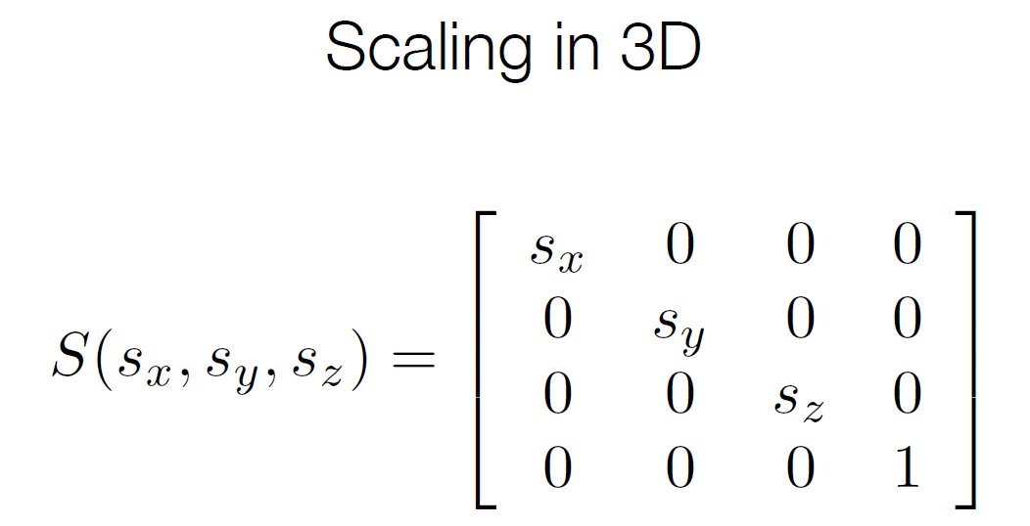

Slide 5
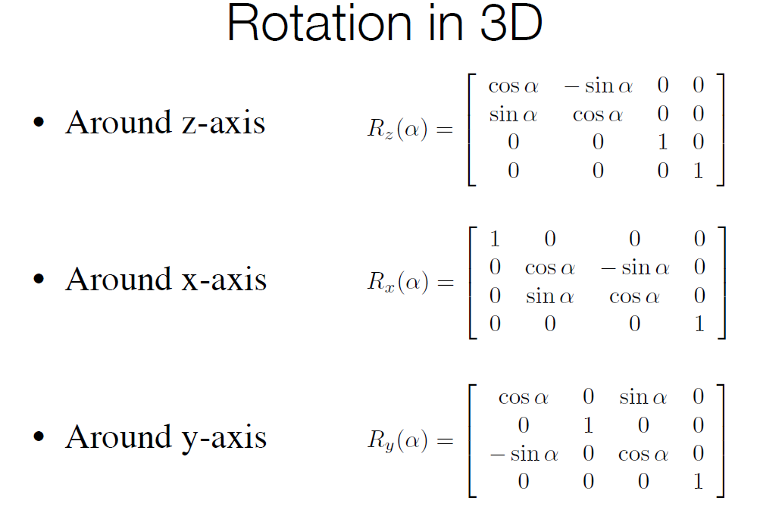

Slide 6
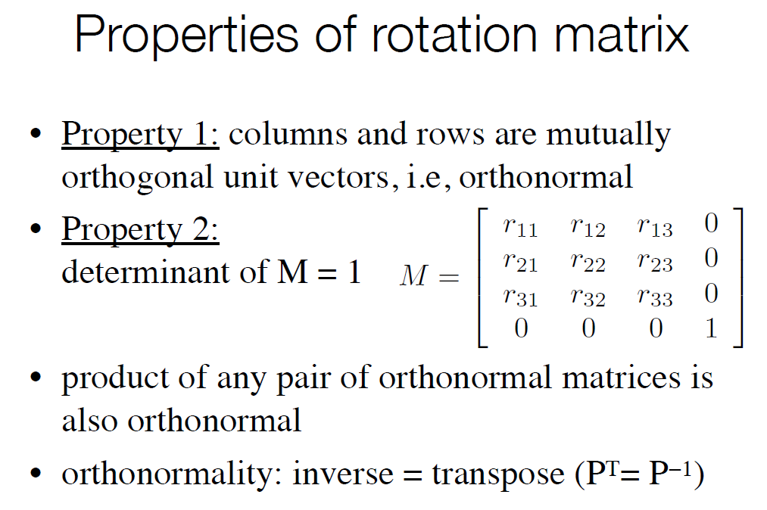

Slide 7
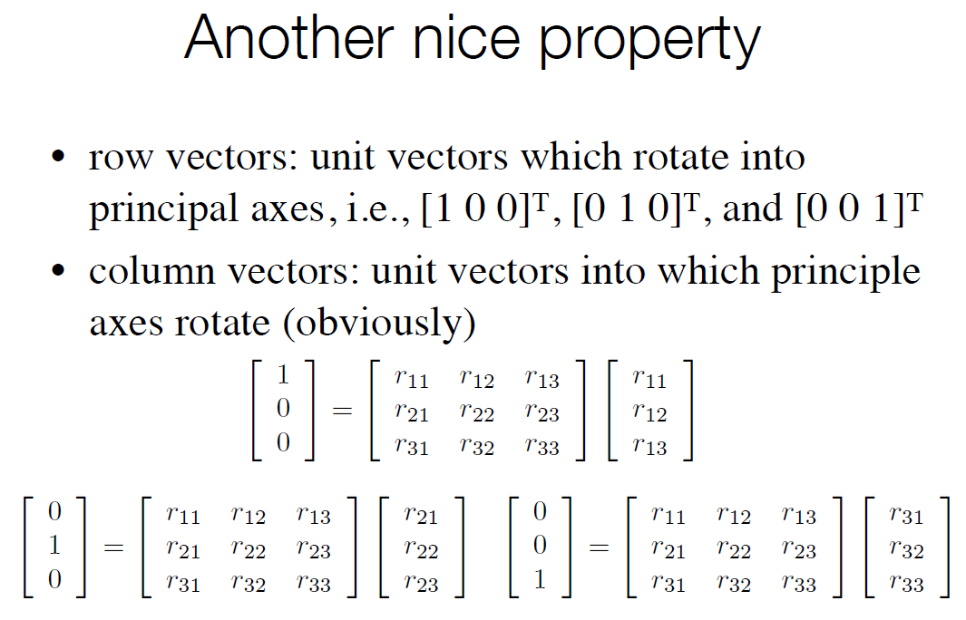

Slide 8
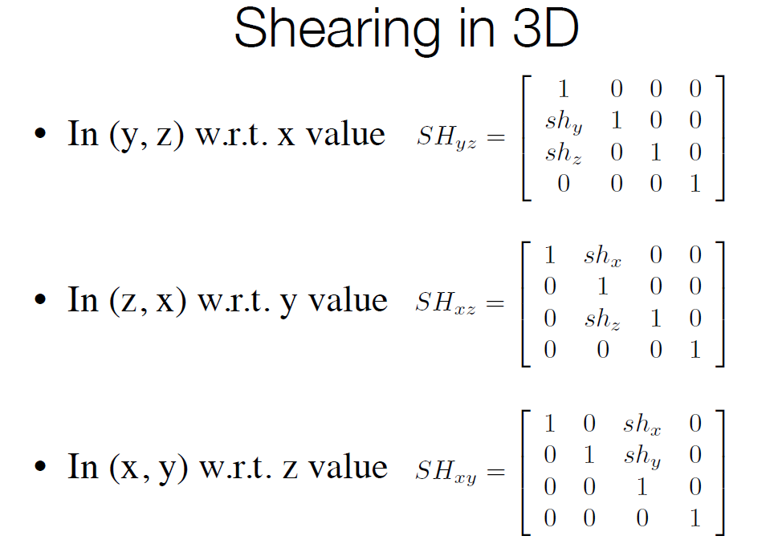

Slide 9
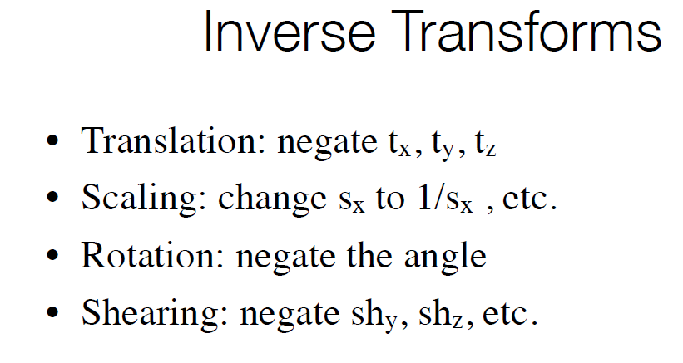

Slide 10
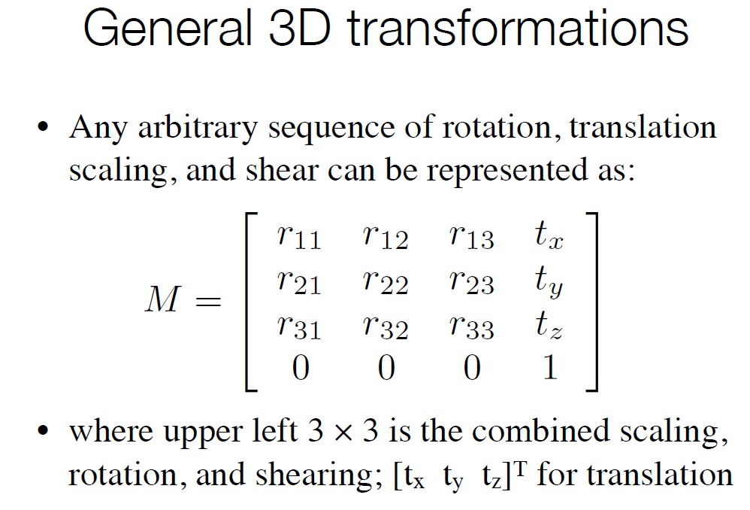

Slide 11
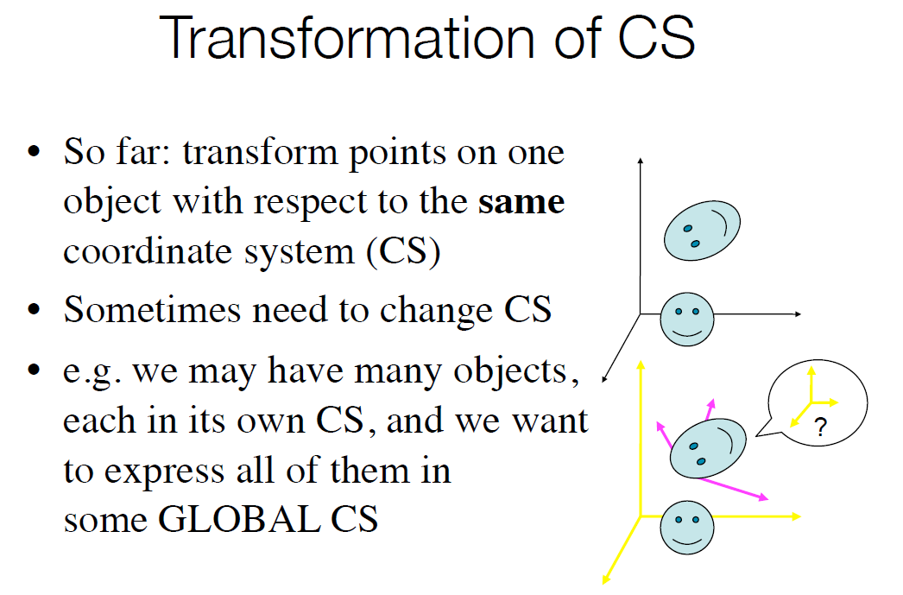

Slide 12
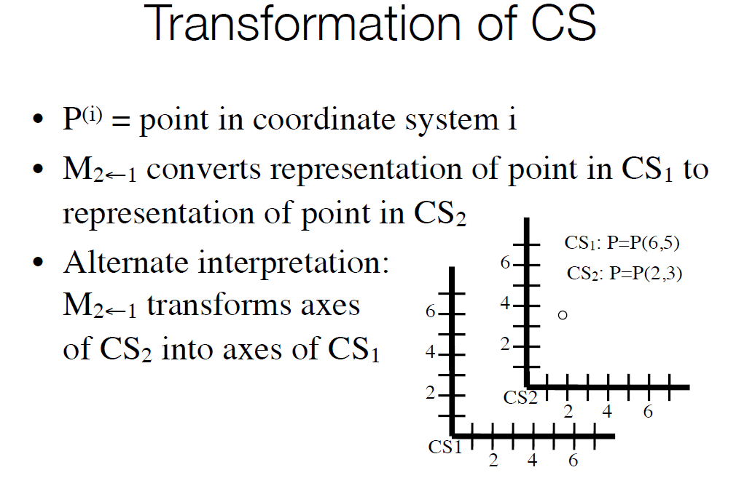

Slide 13
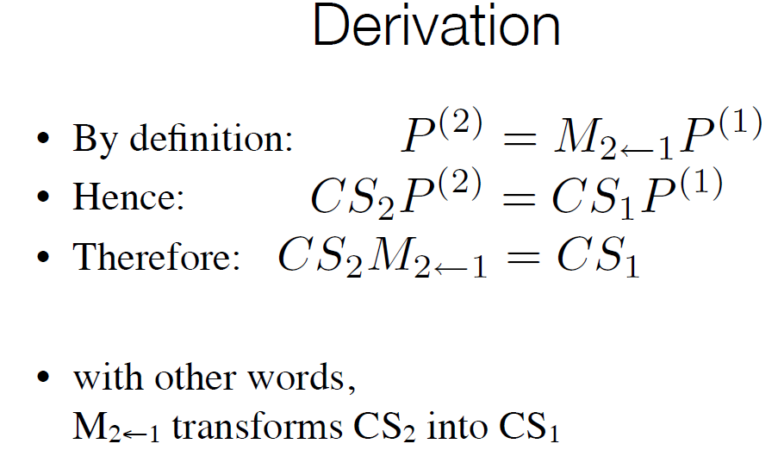

Slide 14
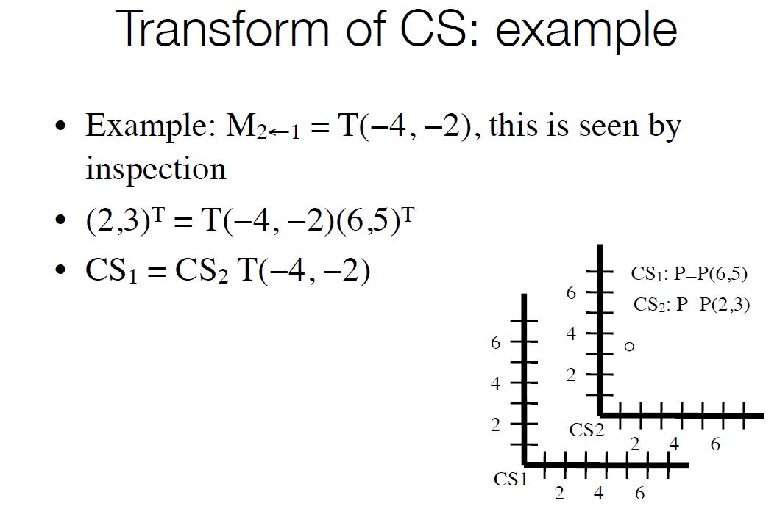

Slide 15
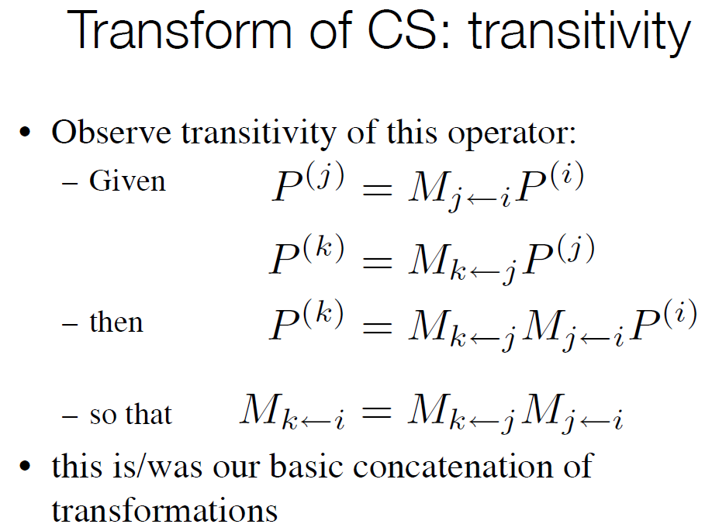

Slide 16
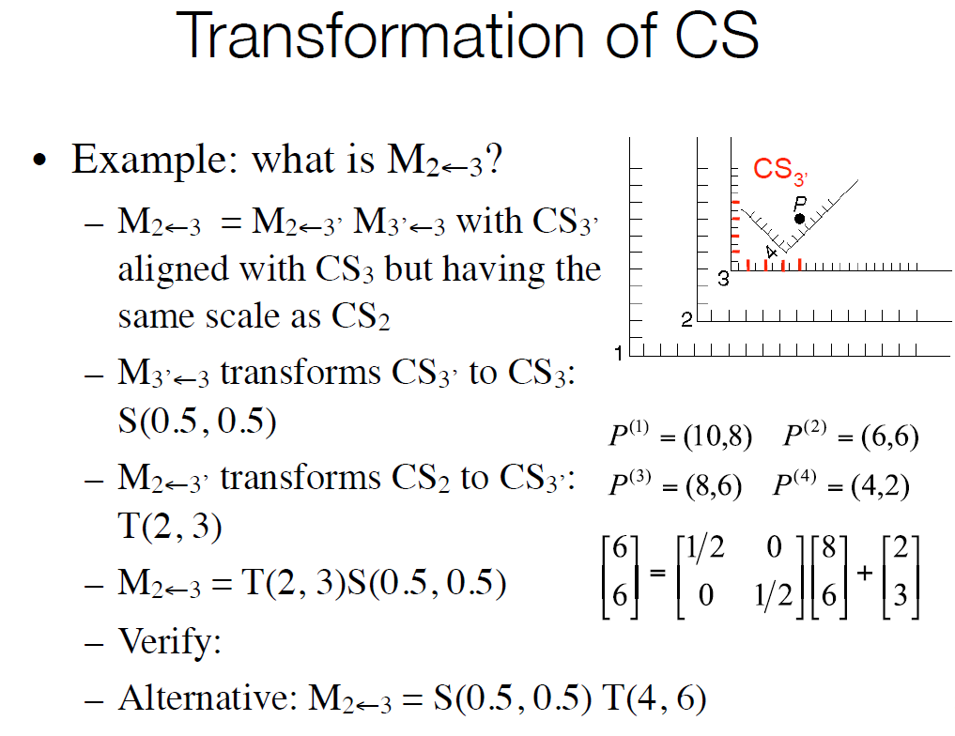

Slide 17
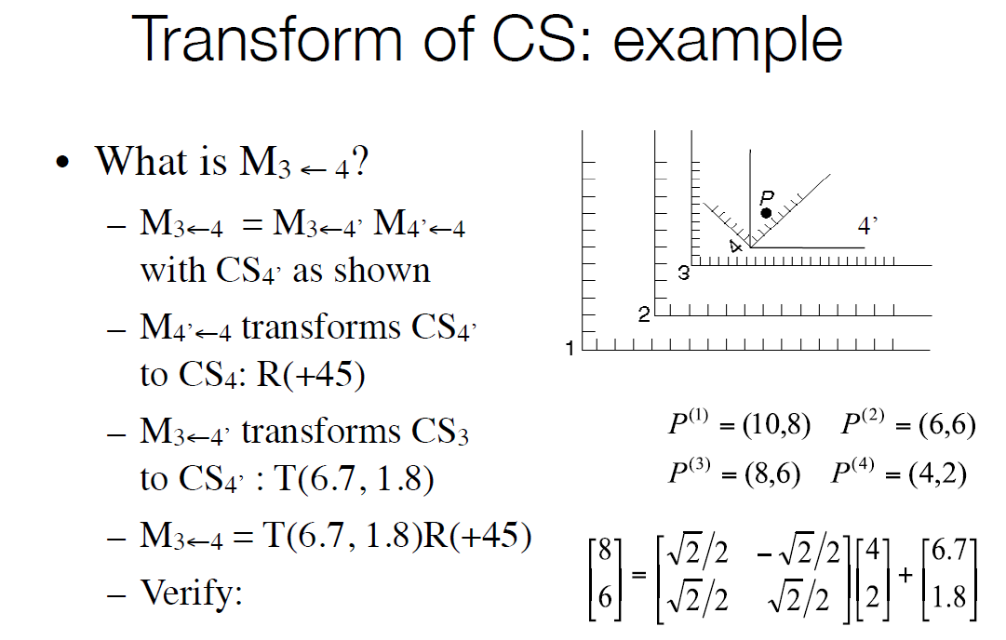

Slide 18
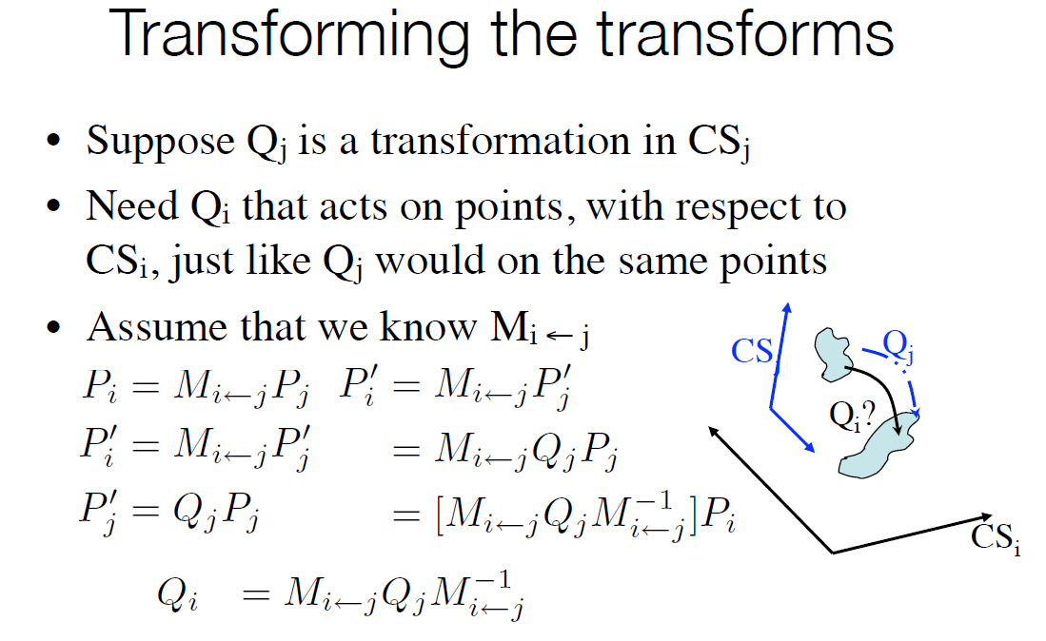

Slide 19
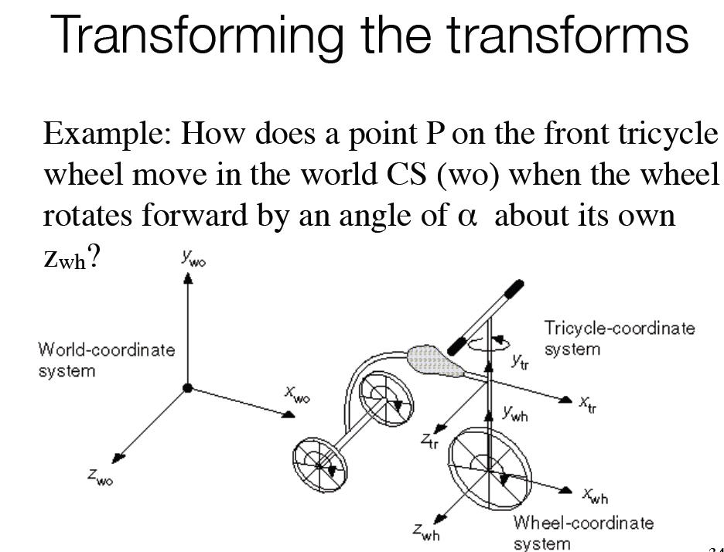

Slide 20
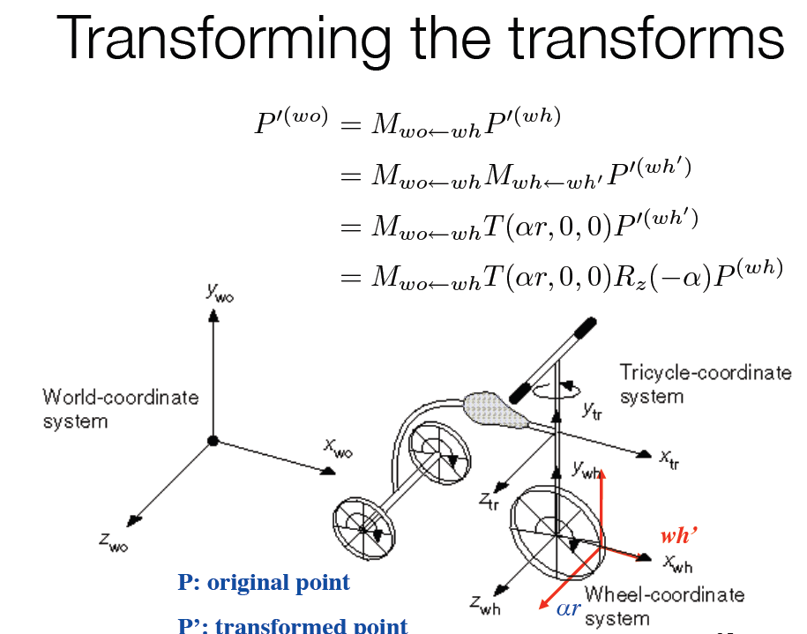

Slide 21
Topics
Synthetic Camera
Steps in 3D Viewing
Projections
Perspective Projections
Parallel Projections
Specification of an Arbitrary 3D View
Graphics Pipeline Revisited

Slide 22
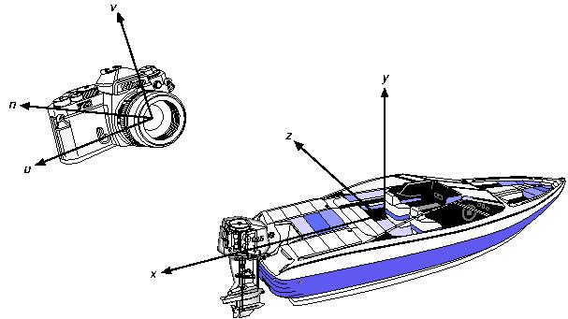
Synthetic Camera
Metaphor for creating 3D scenes:
Coordinate system:
Camera: u, v, n
Object: x, y, z

Slide 23
Steps in 3D Viewing
Projection type specification
Why projection?
Objects 3D, device 2D
Two most important
Perspective
Parallel orthographic
Viewing parameter specification
Viewing plane
Viewing (eye) coordinate system
Scene coordinate system

Slide 24
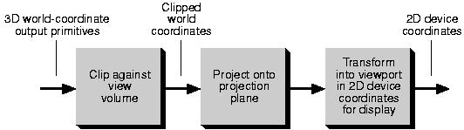
Steps in 3D Viewing
3D clipping
Clip against view volume
Projection and display
Window to viewport transformation
Conceptual model of 3D viewing process

Slide 25
Projections
Projection
Transformation from n-D coordinate system to m-D coordinate system, where m < n
Our concern
n = 3 and m = 2
⇒ projection from 3D to 2D
Terminology
Projectors: Straight projection rays
Center of projection: Where the projectors emanated from
Projection plane: Where the projection forms

Slide 26
Projections
Projection from 3D to 2D defined by
Projectors emanate from COP, pass though each point of the object, and intersect the projection plane
Planar geometric projections
Projection is onto a plane
Referred to as "projections" here

Slide 27
Projections
Two Basic Classes
Perspective
Parallel
Perspective
Distance between projection plane and COP is finite
Visual effect similar to human visual system
Perspective foreshortening:
distance from COP longer, size smaller
Exact shape, measurement, parallelism not reserved

Slide 28
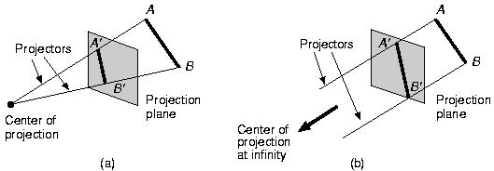
Projections
Parallel
Distance between projection plane and COP is infinite
Less realistic view
No foreshortening
Exact measurement and parallelism preserved
Perspective
Parallel

Slide 29
Perspective Projections
Vanishing Point
Point that set of parallel lines not parallel to the projection plane converge to
Projection of a point at infinity
Axis Vanishing Point
Vanishing point of set of lines parallel to one of three principle axes
At most 3:
x-axis vanishing point
y-axis vanishing point
z-axis vanishing point

Slide 30
Perspective Projections
Example:
If projection plane cuts only z-axis
Only z-axis vanishing point
As lines parallel to x or y axis also parallel to projection plane
Number of Axis Vanishing Points
Can be used to categorize perspective projections
Equal to number of axes cut by projection plane

Slide 31
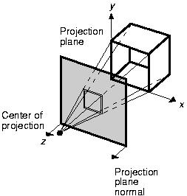
Number of Axis Vanishing Points
One-point
Three-point: hardly used

Slide 32
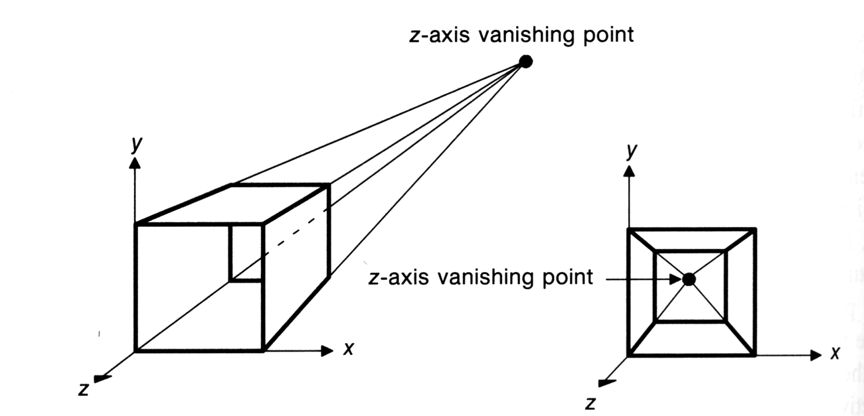
Perspective Projections
2 different examples of a one-point perspective projection of a cube.
(note: x and y parallel lines do not converge)

Slide 33
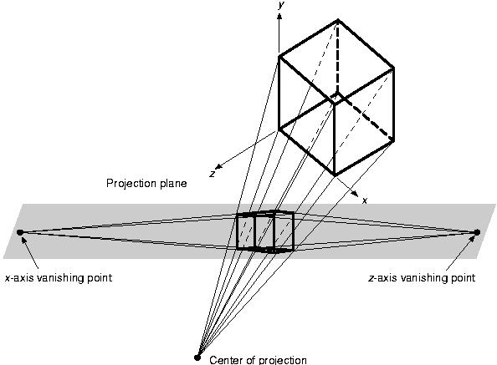
Number of Axis Vanishing Points
Two-point
Commonly used in architecture, engineering, industrial design, and advertising drawings

Slide 34
Parallel Projections
Two types, defined by
Direction of projection (DOP)
Viewing (projection) plane normal (VPN)
Orthographic
DOP and VPN the same (or the reverse)
Obliuqe
DOP of VPN not the same (nor the reverse)

Slide 35
Orthographic Parallel Projections
Projection plane perpendicular to a principle axis
Most common types
Front-elevation
Top-elevation (plane-elevation)
Side-elevation
Used in engineering drawing (such as machine parts)
Hard to deduce 3D nature

Slide 36
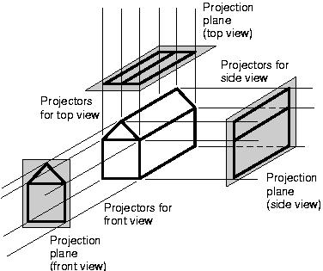
Orthographic Parallel Projections

Slide 37
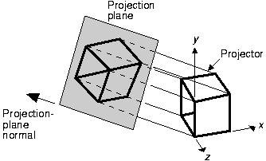
Orthographic Parallel Projections
Axonometric orthographic projections
Projection plane not normal to a principle axis
Several faces of an object can be shown at once
Parallalism reserved, distances can be measured
Example: Isometric projection
VPN = DOP = (dx, dy, dz), where |dx| = |dy| = |dz|
8 directions

Slide 38
Obliuqe Parallel Projections
Projection plane normal and DOP differ
Projection plane is normal to a principle axis
Measurement of distance and angle of faces parallel to the plane allowed
Widely used (easy to draw)
Cavalier
DOP makes 45 degree with projection plane
Cabinet
DOP makes angle of arctan(2) with projection plane

Slide 39
Obliuqe Parallel Projections
Cavalier Cabinet
1
1/2
1
1

Slide 40
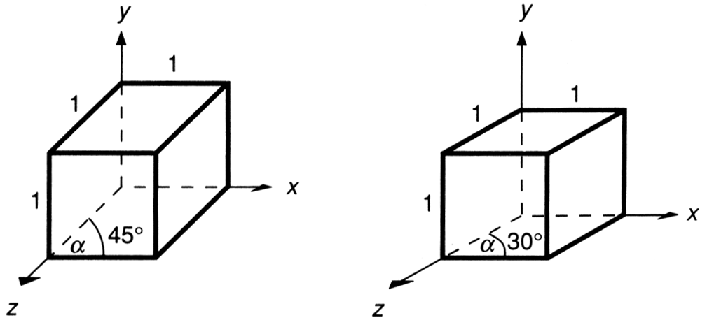
Parallel Projections
Cavalier:
The direction of the projection makes a 45 degree angle with the projection plane.
Because there is no foreshortening, this causes an exaggeration of the z axes.

Slide 41
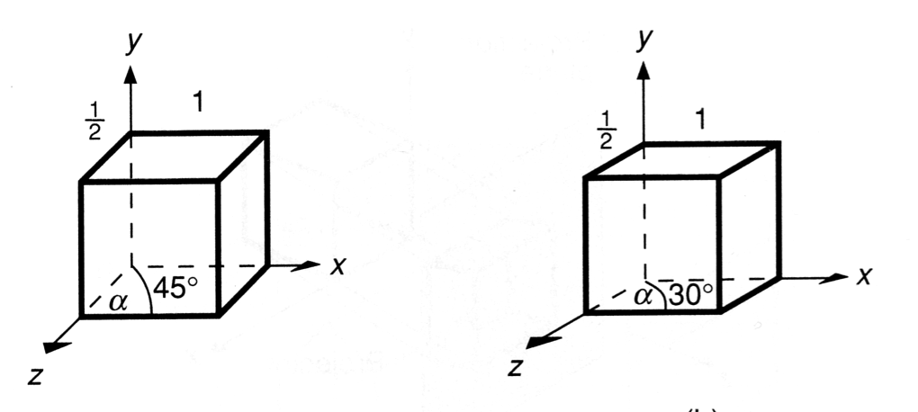
Parallel Projections
Cabinet:
The direction of the projection makes a 63.4 degree angle with the projection plane. This results in foreshortening of the z axis, and provides a more “realistic” view.

Slide 42
Oblique Parallel Projections
Cavalier, cabinet and orthogonal projections can all be specified in terms of (α, β) or (α, λ) since
tan(β) = 1/λ
λ sin(α)
P’
β
λ
α
P=(0, 0, 1)
λ cos(α)

Slide 43
Oblique Parallel Projections
λ=1 | β = 45 | Cavalier projection | α = 0 - 360
λ=0.5 | β = 63.4 | Cabinet projection | α = 0 – 360
λ=0 | β = 90 | Orthogonal projection | α = 0 – 360

Slide 44
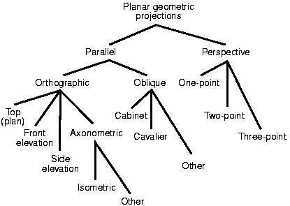
Classification of Planar Geometric Projections

Slide 45
Coordinate Systems
Object coordinates
World coordinates
Camera coordinates
Normalized device coordinates
Window coordinates

Slide 46
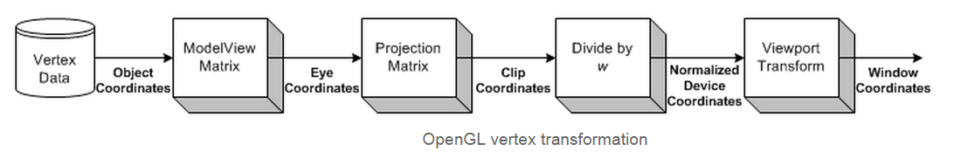

Slide 47
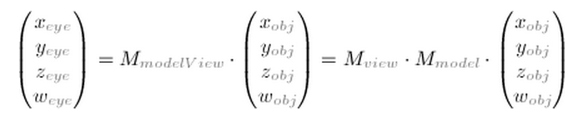
Object Coordinates
It is the local coordinate system of objects and is initial position and orientation of objects before any transform is applied. In order to transform objects, use glRotatef(), glTranslatef(), glScalef().
Eye Coordinates
It is yielded by multiplying GL_MODELVIEW matrix and object coordinates. Objects are transformed from object space to eye space using GL_MODELVIEW matrix in openGL. GL_MODELVIEW matrix is a combination of Model and View matrices (M_{view}, M_{model}). Model transform is to convert from object space to world space. And, View transform is to convert from world space to eye space.

Slide 48
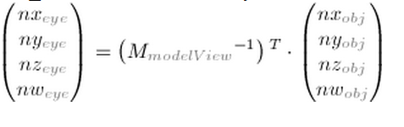
Eye Coordinates
Note that there is no separate camera (view) matrix in OpenGL. Therefore, in order to simulate transforming the camera or view, the scene (3D objects and lights) must be transformed with the inverse of the view transformation. In other words, OpenGL defines that the camera is always located at (0, 0, 0) and facing to -Z axis in the eye space coordinates, and cannot be transformed.
Normal vectors are also transformed from object coordinates to eye coordinates for lighting calculation. Note that normals are transformed in different way as vertices do. It is mutiplying the tranpose of the inverse of GL_MODELVIEW matrix by a normal vector.

Slide 49
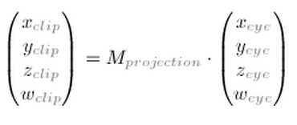
Clip Coordinates
The eye coordinates are now multiplied with GL_PROJECTION matrix, and become the clip coordinates. This GL_PROJECTION matrix defines the viewing volume (frustum); how the vertex data are projected onto the screen (perspective or orthogonal). The reason it is called clip coordinates is that the transformed vertex (x, y, z) is clipped by comparing with ±w.

Slide 50
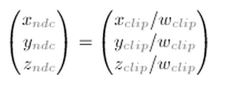
Normalized Device Coordinates (NDC)
It is yielded by dividing the clip coordinates by w. It is called perspective division. It is more like window (screen) coordinates, but has not been translated and scaled to screen pixels yet. The range of values is now normalized from -1 to 1 in all 3 axes.

Slide 51
Window Coordinates (Screen Coordinates)
It is yielded by applying normalized device coordinates (NDC) to viewport transformation. The NDC are scaled and translated in order to fit into the rendering screen. The window coordinates finally are passed to the rasterization process of OpenGL pipeline to become a fragment. glViewport() command is used to define the rectangle of the rendering area where the final image is mapped. And, glDepthRange() is used to determine the z value of the window coordinates. The window coordinates are computed with the given parameters of the above 2 functions; glViewport(x, y, w, h); glDepthRange(n, f);

Slide 52
Specifying an Arbitrary View
What do we need to specify an arbitrary view?
1. Projection plane (or View plane)
Specified with a point and a normal.
Call the point on the plane the “View Reference Point” or VRP.
Call the normal to the plane the “View Plane Normal” or VPN.
We can define these anywhere in world space.
View Plane
VRP
VPN

Slide 53
Specifying and Arbitrary View
What else?
2. A window in the infinite view plane
We want to specify a subset of the view plane that we will project onto the screen
Objects outside the window will not be seen
How do we define that window?
Very difficult to do in world coordinates!
Window
View Plane
VRP
VPN

Slide 54
Specifying the Window
We would like to specify the window relative to the VRP (some number of units above, below, left and right)
To do this, we must create a new coordinate system
This will be called the “View-Reference Coordinate System” (VRC)
The origin of the VRC is the VRP
One axis is the VPN
A second axis will be the “up” axis
This will need to be specified by the programmer
It is simply the direction that is to be “up”
i.e. the up direction of the eye or camera

Slide 55
Specifying the Window
The “view up” vector (VUP) is projected onto the viewplane to get the second (V) axis
This allows the programmer to specify any vector - not just a vector exactly perpendicular to N
VUP projected onto View Plane
(V axis)
View Plane
VUP
VRP (Origin)
VPN (N axis)

Slide 56
Specifying the Window
The third axis (U) is a vector perpendicular to both V and N
VUP projected onto View Plane
(V axis)
View Plane
VRP (Origin)
U axis
VPN (N axis)

Slide 57
Computing the VRC system
How do we determine these vectors?
VRP and VPN are specified
N = VPN
View Up is specified
U = VUP x N
V = N x U
V
View Plane
VUP
U
N

Slide 58
Specifying the Window
With the VRC system defined, we can now specify the window
Window = (u_{min}, v_{min}) -> (u_{max}, v_{max})
the Center of the Window (CW) is midway between
(u_{min}, v_{min}) and (u_{max}, v_{max})
V
(u_{max}, v_{max})
View Plane
CW
U
(u_{min}, v_{min})
N

Slide 59
Specifying an Arbitrary View
Back to specifying our arbitrary view
What else do we need?
3. Projection type
Parallel
Perspective
V
(u_{max}, v_{max})
View Plane
CW
U
(u_{min}, v_{min})
N

Slide 60
Specifying an Arbitrary View
What else do we need?
4. Projection Reference Point (PRP)
Specified in VRC
For perspective projection, it is the center of projection
Defines the view volume
as a semi-infinite
pyramid whose apex
is the PRP
V
View Plane
U
N
PRP
Center of Projection

Slide 61
Specifying an Arbitrary View
For parallel projection, the direction of projection is obtained from the PRP and the CW
The view volume is an infinite parallelepiped with sides parallel to the direction of projection (DOP) passing through the borders of the window.
Viewplane
V
DOP
CW
U
N
PRP

Slide 62
Specifying an Arbitrary View
Perspective Viewing
And Finally:
5. Front and back clipping planes
If desired
Limits the view volume
to a finite volume and
clips objects that don’t
fall within it
Back Clipping Plane
Window
Front
Clipping
Plane
VRP
Back
Front

Slide 63
Specifying an Arbitrary View
Parallel Viewing
Back Clipping Plane
Window
Front
Clipping
Plane
VRP
Back
Front

Slide 64
Specifying an Arbitrary View Summary
Need to specify:
View Reference Point - VRP
Projection Reference Point - PRP
View Plane Normal - VPN
View Up vector - VUP
Window bounds
Can be specified either as
(u_{min}, v_{min}), (u_{max}, v_{max}) or
FieldOfView_{x}, FieldOfView_{y}
Projection Type

Slide 65
Specifying an Arbitrary View Summary
Generally this is simplified for the user to:
LookAt Point - VRP
LookFrom Point - PRP, view point, or center of projection
View Up vector - VUP
Field of View - gives the window size (could be different for vertical and horizontal, or could be the same)
Projection Type
Then with these quantities specified:
VRP = LookAt
PRP = LookFrom
VPN = LookFrom - LookAt
N = VPN
U = VUP X N
V = N X U

Slide 66
Arbitrary View
Back Plane
So, we have:
V
View Plane
Field of View
in U
VUP
LookAt
U
Front Plane
LookFrom
Field of View
in V
N

Slide 67
Perspective Viewing with OpenGL
Positioning and aiming camera
glMatrixMode(GL_MODELVIEW);
glLoadIdentity();
gluLookAt(eye.x, eye.y, eye.z, // eye position
look.x, look.y, look.z, // look at point
up.x, up.y, up.z) // up vector
Up vector is often set to (0, 1, 0)

Slide 68
Transformation Matrix for LookAt
Camera coordinate system
Axes: u, v, n
n = eye – look
u = up × n
v = n × u
Origin: eye (looking in the direction –n)
If up = (0, 1, 0) then
u = (n_{z}, 0, -n_{x}) i.e., horizontal
v = (-n_{x} n_{y}, n_{x}²+n_{z}², -n_{z} n_{y}) i.e., more or less upward

Slide 69
Color models for Raster Graphics

Slide 70

Color Model
Overview
Color.
Color Model.
Types of Color Model.
Additive vs. Subtractive Color Models

Slide 71
Color Model
* What is the color?
Color is a sensation produced by the human eye and nervous system.
- It is related to light, but an understanding of the properties of light is not sufficient to understand color, and is especially not sufficient to understand the art of color reproduction.

Slide 72

Color Model
* What is the color?
It is useful to represent a color by a set of exactly three numbers.
- In practice, the set of three numbers must be related to some actual color reproduction process. The numbers commonly specify portions of some set of primary colors such as:

Slide 73
Color Model
* Color model.
A color model is an orderly system for creating a whole range of colors from a small set of primary colors.

Slide 74
Color Model
* Types of Color model.
There are two types of color models, those that are subtractive and those that are additive. Additive color models use light to display color while subtractive models use printing inks. Colors perceived in additive models are the result of transmitted light. Colors perceived in subtractive models are the result of reflected light.

Slide 75
Color Model
* Types of Color model.
The Two Most Common Color Models:
There are several established color models used in computer graphics, but the two most common are the RGB model (Red-Green-Blue) for computer display and the CMYK model (Cyan-Magenta-Yellow-blacK) for printing.

Slide 76
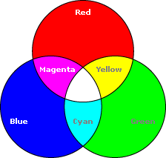
Color Model
* Types of Color model.
RGB Color Model:
* Additive color model.
* For computer displays.
* Uses light to display color.
* Colors result from transmitted light.
* Red + Green + Blue = White.

Slide 77
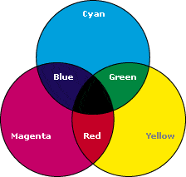
Color Model
* Types of Color model.
2) CMYK Color Model:
* Subtractive color model.
* For printed material.
* Uses ink to display color.
* Colors result from reflected light.
* Cyan + Magenta + Yellow = Black.

Slide 78
Color Model
the color model RGB is used in hardware applications like PC monitors, cameras and scanners, the CMY color model is used in color printers,
Each color can be a point in the RGB color model cube. Red, green and blue are known as the primary colors. These colors can be added to produce secondary colors which are:
magenta = red + blue
cyan = green +blue
yellow = red + green
Other possible combinations:
white = blue (primary) + yellow (secondary)
white = green (primary) + magenta (secondary)
white = red (primary) + cyan (secondary)

Slide 79
Color Model
Additive vs. Subtractive Color Models
Since additive color models display color as a result of light being transmitted (added) the total absence of light would be perceived as black. Subtractive color models display color as a result of light being absorbed (subtracted) by the printing inks. As more ink is added, less and less light is reflected. Where there is a total absence of ink the resulting light being reflected (from a white surface) would be perceived as white.

Slide 80
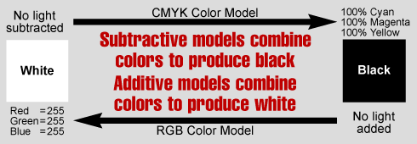
Color Model

Slide 81
Color Model
Use RGB For Screen Displays and CMYK For Print
- It is important to choose the right color model for the job. If your images will be printed, then convert them to CMYK and manually bring them into gamut before printing. If your images are to be displayed on a computer, then make sure you use RGB color so the full gamut will be available for display. Because both models can be available at the same time while using an application, it is easy to make a mistake and choose the wrong palette or set of color swatches.

Slide 82
How Do Artists Do It?
Artists often specify color as tints, shades, and tones of saturated (pure) pigments
Tint: Gotten by adding white to a pure pigment, decreasing saturation
Shade: Gotten by adding black to a pure pigment, decreasing lightness
Tone: Gotten by adding white and black to a pure pigment
White
Tints
Grays
Tones
Pure Color
Shades
Black

Slide 83
Color Models for Raster Graphics
Hardware-oriented models: not intuitive – do not relate to concepts of hue, saturation, brightness
RGB, used with color CRT monitors
YIQ, broadcast TV color system
CMY (cyan, magenta, yellow) color printing
CMYK (cyan, magenta, yellow, black) color printing
IRODORI, six-primary-color projection system
User-oriented models
HSV (hue, saturation, value)
also called HSB (B for brightness)
HLS (hue, lightness, saturation)
The Munsell system
CIE Lab

Slide 84
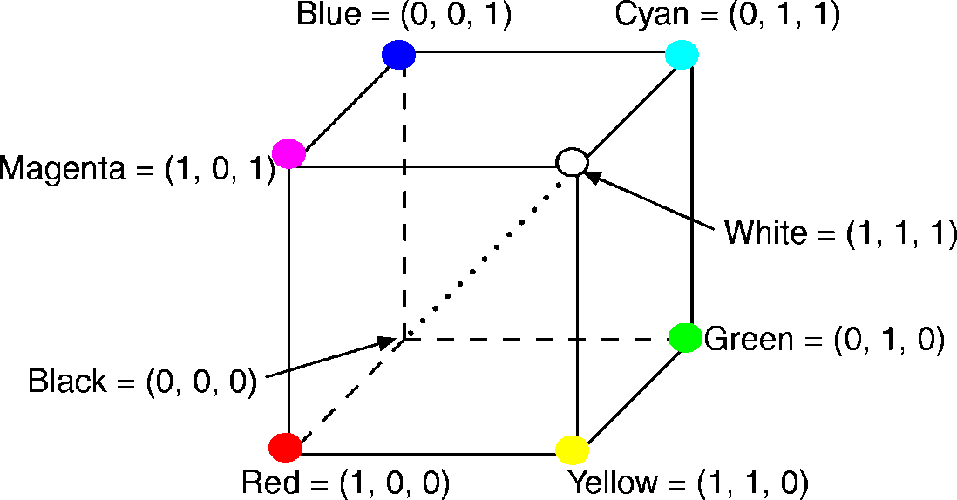
RGB Color Model
The RGB primaries are additive primaries.
The individual contributions of each primary are added together to yield the result.
Main diagonal => gray levels
black is (0, 0, 0)
white is (1, 1, 1)
The RGB cube (Grays on dotted main diagonal)

Slide 85
RGB Color Model
The color gamut covered by the RGB model is defined by the chromaticities of a CRT’s phosphors.
Two CRTs with different phosphors will cover different gamuts.
Conversion between colors specified in the gamut of one CRT to the gamut of another CRT.
Convert one to XYZ, then convert from XYZ to another

Slide 86
RGB Color Model
Each transformation
X_{r}, X_{g} and X_{b} are the weights applied to the monitors’ RGB colors to find X and so on.
With M₁ and M₂ the matrices that convert from each of the two monitor’s gamuts to CIE, M₂⁻¹M₁ converts from the RGB of monitor 1 to the RGB of monitor 2.
⎡
X
⎤
⎡
X
X
X
⎤
⎡
R
⎤
⎢
⎥
⎢
r
g
b
⎥
⎢
⎥
⎢
Y
⎥
=
⎢
Y
Y
Y
⎥
⎢
G
⎥
r
g
b
⎢
Z
⎥
⎢
Z
Z
Z
⎥
⎢
B
⎥
⎣
⎦
⎣
r
g
b
⎦
⎣
⎦

Slide 87
RGB Color Model
What if a color C₁ is in the gamut of monitor 1 but is not in the gamut of monitor 2?
C₂ = M₂⁻¹ M₁ C₁ will be outside the unit cube and hence will not be displayable.
Solution 1
Clamp the color values: To replace values of R, G, or B that are less than 0 with 0, and values that are greater than 1 with 1.
simple, but distorts color relations

Slide 88
RGB Color Model
Solution 2
Compress gamut on monitor 1 by scaling all colors from monitor 1 toward center of gamut 1
Ensure that all displayed colors on monitor 1 map onto monitor 2

Slide 89
CMY Color Model
CMY stands for Cyan, Magenta, and Yellow, which are the complements of red, green and blue, respectively.
Subtractive primaries: Used as filters to subtract color from white light.
The subset of the Cartesian coordinate system for the CMY model is the same as that for RGB except that white (full light) instead of black (no light) is at the origin.
Colors are specified by what is removed or subtracted from white light, rather than by what is added to blackness.

Slide 90
CMY Color Model
Relations between RGB and CMY
The unit column vector is the RGB representation for white and the CMY representation for black.
Green
Yellow
(minus blue)
⎡
C
⎤
⎡
1
⎤
⎡
R
⎤
⎢
M
⎥
=
⎢
1
⎥
−
⎢
G
⎥
⎢
⎥
⎢
⎥
⎢
⎥
⎢
Y
⎥
⎢
1
⎥
⎢
B
⎥
(minus red)
Cyan
⎣
⎦
⎣
⎦
⎣
⎦
Black
Red
Blue
Magenta
(minus green)

Slide 91
CMY Color Model
Another color model, CMYK, uses black as a fourth color.
Given a CMY specification, black is used in place of equal amounts of C, M, and Y, according to the relations:
K:=min(C,M,Y)
C:= C – K
M:= M – K
Y:= Y - K

Slide 92
CMY Color Model
A knowledge of CMY is important when dealing with hardcopy devices that deposit colored pigments onto paper: electrostatic and ink-jet plotters.
When a surface is coated with cyan ink, no red light is reflected from the surface.
Cyan subtracts red from the reflected white light.
Cyan is white minus red, that is blue plus green.
Magenta absorbs green, so it is red plus blue.
Etc.

Slide 93
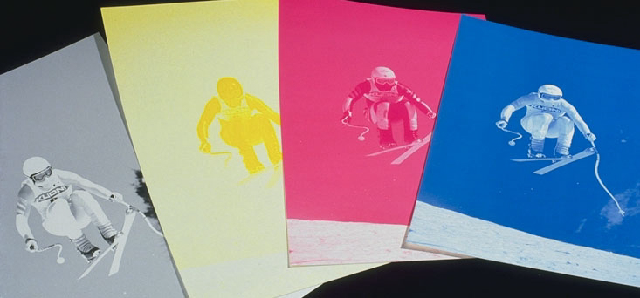

CMY Color Model
CMYK Separations
Red = magenta + yellow
Green = yellow + cyan
Blue = cyan + magenta
Black for contrast
Obtained from SIGGRAPH 2001 course note.

Slide 94
YIQ Color Model
It is used in U.S. commercial color television broadcasting.
It is closely related to color raster graphics.
YIQ is a recording of RGB
for transmission efficiency
for downward compatibility with black-and-white television.

Slide 95
YIQ Color Model
Y component: luminance
Defined to be the same as the CIE Y primary.
Only the Y component of a color TV signal is shown on black-and-white televisions
The chromaticity is encoded in I and Q.
It uses a 3D Cartesian coordinate system
The visible subset is a convex polyhedron that maps into the RGB cube.
The RGB-to-YIQ mapping
⎡
Y
⎤
⎡
0
.
30
0
.
59
0
.
11
⎤
⎡
R
⎤
⎢
⎥
=
⎢
−
−
⎥
⎢
⎥
⎢
I
⎥
⎢
0
.
60
0
.
28
0
.
32
⎥
⎢
G
⎥
⎢
Q
⎥
⎢
0
.
21
−
0
.
52
0
.
31
⎥
⎢
B
⎥
⎣
⎦
⎣
⎦
⎣
⎦

Slide 96
YIQ Color Model
Only Y = 0.299R + 0.587G + 0.114B shown on B/W monitors
Specifying colors with the YIQ model shoves a potential problem with material being prepared for broadcast television.

Slide 97
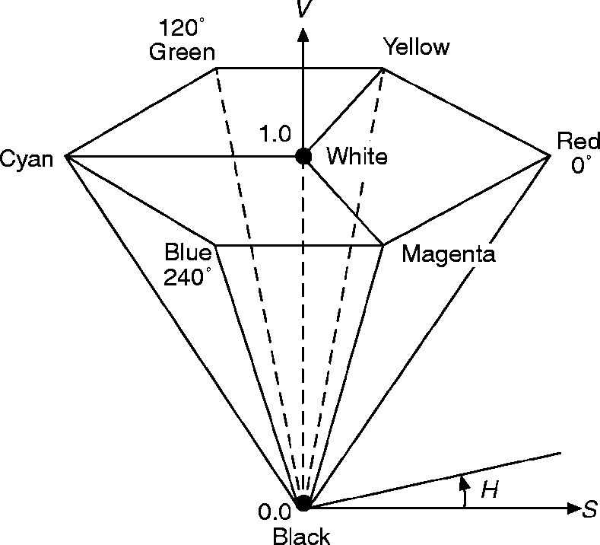
HSV Color Model
HSV stands for Hue, Saturation and Value.
Also called the HSB model, with B for brightness.
It is based on the intuitive appeal of the artist’s tint, shade and tone.
The coordinate system is cylindrical.
The subset of the space within which the model is defined is a hexcone, or six-sided pyramid.
Single hexcone HSV color model. (The V = 1 plane contains the RGB model’s R = 1, G = 1, B = 1, in the regions shown)

Slide 98
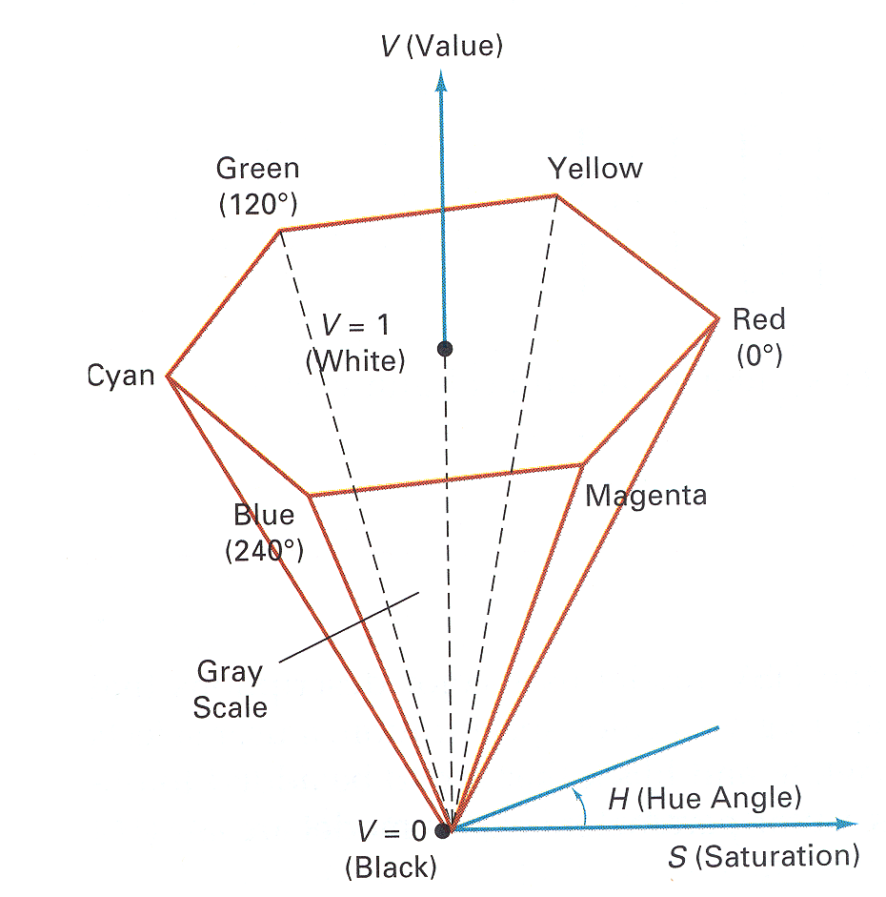
HSV Color Model
H S V Color
0 1.0 1.0 Red
120 1.0 1.0 Green
240 1.0 1.0 Blue
* 0.0 1.0 White
* 0.0 0.5 Gray
* * 0.0 Black
60 1.0 1.0 ?
270 0.5 1.0 ?
270 0.0 0.7 ?
Figure 15.16&15.17 from H&B

Slide 99
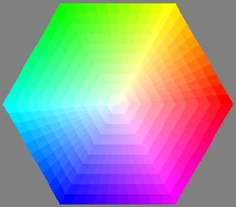
Intuitive Color Spaces
A top-down view of hexcone

Slide 100
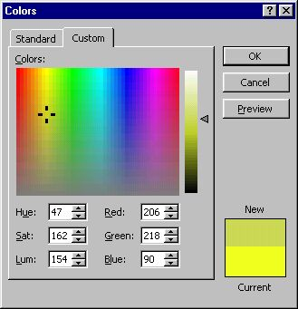
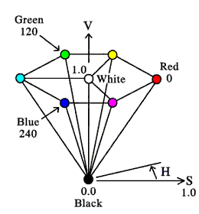
HSV Color Space
A more intuitive color space
H = Hue
S = Saturation
V = Value (or brightness)
Saturation
Value
Hue

Slide 101
HSV Color Model
Hue (H) is measured by the angle around the vertical axis, with red at 0º, green at 120º and so on.
Complementary colors in the HSV hexcone are 180º opposite one another.
Single hexcone HSV color model. (The V = 1 plane contains the RGB model’s R = 1, G = 1, B = 1, in the regions shown)

Slide 102
HSV Color Model
The value of S is a ratio ranging from 0 on the center line (V axis) to 1 on the triangular sides of the hexcone.
Saturation is measured relative to the color gamut represented by the model, which is a subset of the entire CIE chromaticity diagram.
Saturation of 100 percent in the model is less than 100 percent excitation purity.
Single hexcone HSV color model. (The V = 1 plane contains the RGB model’s R = 1, G = 1, B = 1, in the regions shown)

Slide 103
HSV Color Model
The hexcone is one unit high in V, with the apex at the origin.
The point at the apex is black and has a V coordinate of 0.
At this point, the values of H and S are irrelevant.
The point S = 0, V = 1 is white.
Intermediate values of V for S = 0 (on the center line) are the grays.
When S = 0, the value of H is irrelevant. When S is not zero, H is relevant.
Pure red is at H = 0, S = 1, V = 1.
Single hexcone HSV color model. (The V = 1 plane contains the RGB model’s R = 1, G = 1, B = 1, in the regions shown)

Slide 104
HSV Color Model
Any color with V = 1, S = 1 is akin to an artist’s pure pigment.
Adding white pigment corresponds to decreasing S (without changing V).
Shades are created by keeping S = 1 and decreasing V.
Tones are created by decreasing both S and V.
Single hexcone HSV color model. (The V = 1 plane contains the RGB model’s R = 1, G = 1, B = 1, in the regions shown)

Slide 105
HSV Color Model
We can convert from RGB to HSV color space and from HSV to RGB.
A code for conversion can be obtained from the Internet.

Slide 106
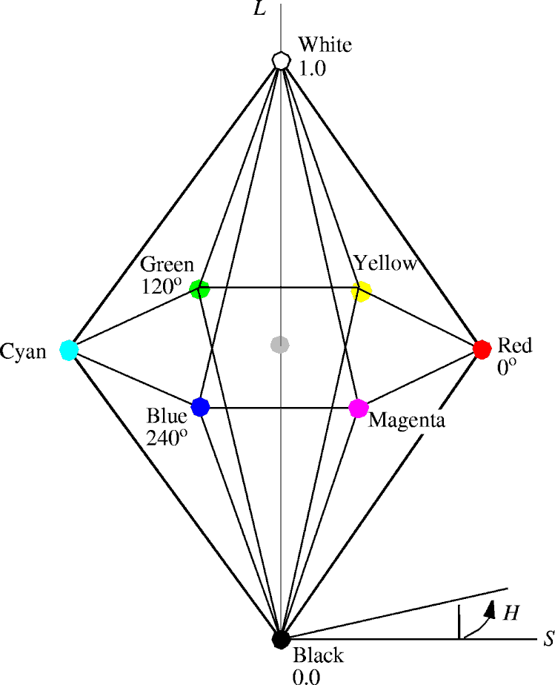
HLS Color Model
HLS stands for Hue, Lightness and Saturation.
It is defined in the double-hexcone subset of a cylindrical space.
Hue is the angle around the vertical axis of the double hexcone.
Red at 0º.
The colors occur around the perimeter in the same order as in the CIE diagram when its boundary is traversed counterclockwise: red, yellow, green, cyan, blue and magenta.

Slide 107
HLS Color Model
We can think of HLS as a deformation of HSV, in which white is pulled upward to form the upper hexcone from the V=1 plane.
The complement of any hue is located 180º farther around the double hexcone.
Saturation is measured radially from the vertical axis.
From 0 on the axis to 1 on the surface.
Lightness is 0 for black (at the lower tip of the double hexcone) to 1 for white (at the upper tip).

Slide 108
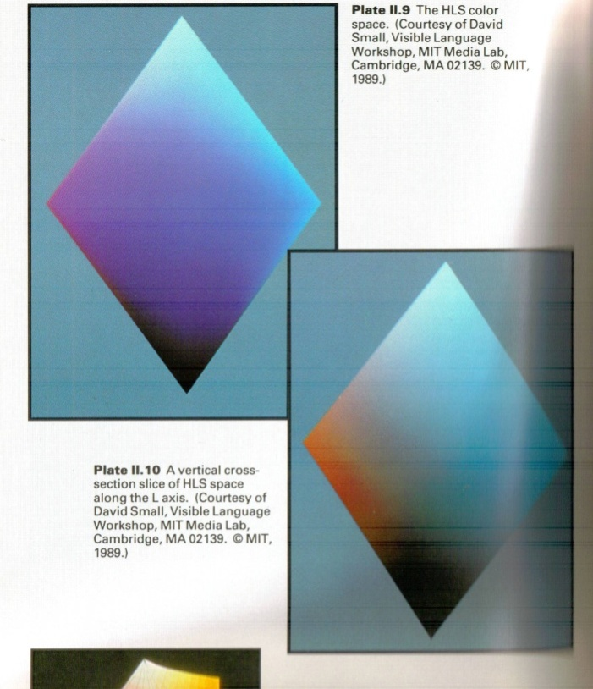
HLS Color Model
The grays all have S = 0.
The maximally saturated hues are at S = 1, L = 0.5.
Easy to use.

Slide 109
Interactive Specification of Color
Basic choice : use English-language name.
To specify the numeric coordinates of the color in a color space.
Ambiguous and subjective : (a light navy blue with a touch of green???????)

Slide 110
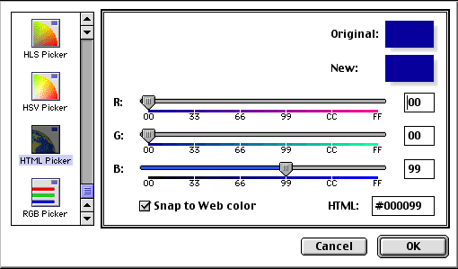
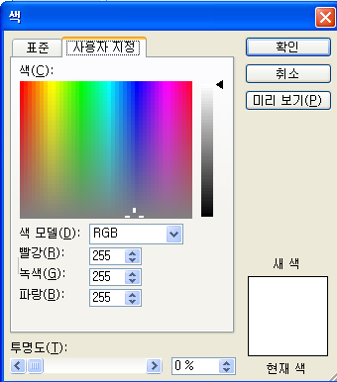
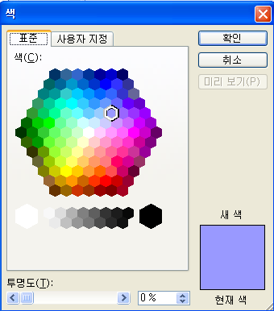
Interactive Specification of Color
Numeric coordinates in color space
A user can change the numeric coordinate values by sliding dials.
Or enter numeric values
Interactively see the color produced by those numeric values to understand the effects of the color change.

Slide 111
Interactive Specification of Color
Color-matching experiments
Subjects used a data tablet to specify colors in several models including RGB, YIQ, LAB and HSV.
HSV was found to be slow but accurate.
RGB is faster but less accurate.

Slide 112


Interactive Specification of Color

Slide 113
Interpolating in Color Space
Color interpolation is necessary
For Gouraud shading
For antialiasing
In blending two images together as for a fade-in, fade-out sequence.
The results of the interpolation depend on the color model in which the colors are interpolated.
The choice of a color model is very important.

Slide 114
Interpolating in Color Space
Conversion between RGB, CMY, YIQ and CIE color models
Affine transformation: a straight line in one color model is transformed into a straight line in the other color model.
Conversion between RGB and HSB or HLS model.
A straight line in RGB does not in general transform into a straight line in either HSB or HLS model.

Slide 115
Interpolating in Color Space
for example, interpolation between red and green in RGB:
interpolating in HSV:
midpoint values in RGB differ by 0.5 from same interpolation in HSV:
(60º, 1, 0.5) ≠ (60º, 1, 1)
red = (1, 0, 0), green = (0, 1, 0)
midpoint = (0.5, 0.5, 0)
red = (0º, 1, 1); green = (120º, 1, 1)
midpoint = (60º, 1, 1)
RGB_to_HSV = (60º, 1, 0.5)

Slide 116
Interpolating in Color Space
For Gouraud shading, use any of the models because interpolants are generally so close together that interpolation paths are close together.
For blending two images, as in fade-in fade-out sequence or for antialiasing, colors may be quite distant.
use additive model, such as RGB.
If interpolating between two colors of fixed hue (or saturation), maintain fixed hue (saturation) for all interpolated colors by HSV or HLS.
note fixed-saturation interpolation in HSV or HLS is not seen as having exactly fixed saturation by viewer!

Slide 117


Using Color in Computer Graphics
Aesthetic uses
Highlight
Code numeric quantities
Scientific visualization: fluids in computational fluid dynamics (streamlines)
Color legends

Slide 118
Using Color in Computer Graphics
Color Selection
Visually appealing.
Convey a message.
The basic concepts of color terminology, harmony and palettes need to be defined precisely and used for proper color design.

Slide 119
Using Color in Computer Graphics
Careless use of color is perilous
in experiments, poor color choices reduced user performance by one-third
“Worst Website”:
http://www.angelfire.com/super/badwebs/main.htm
Decorative use of color subservient to functional use
design first for a monochrome display (color use is redundant in monochrome displays and for color-blind users)

